Slide 1
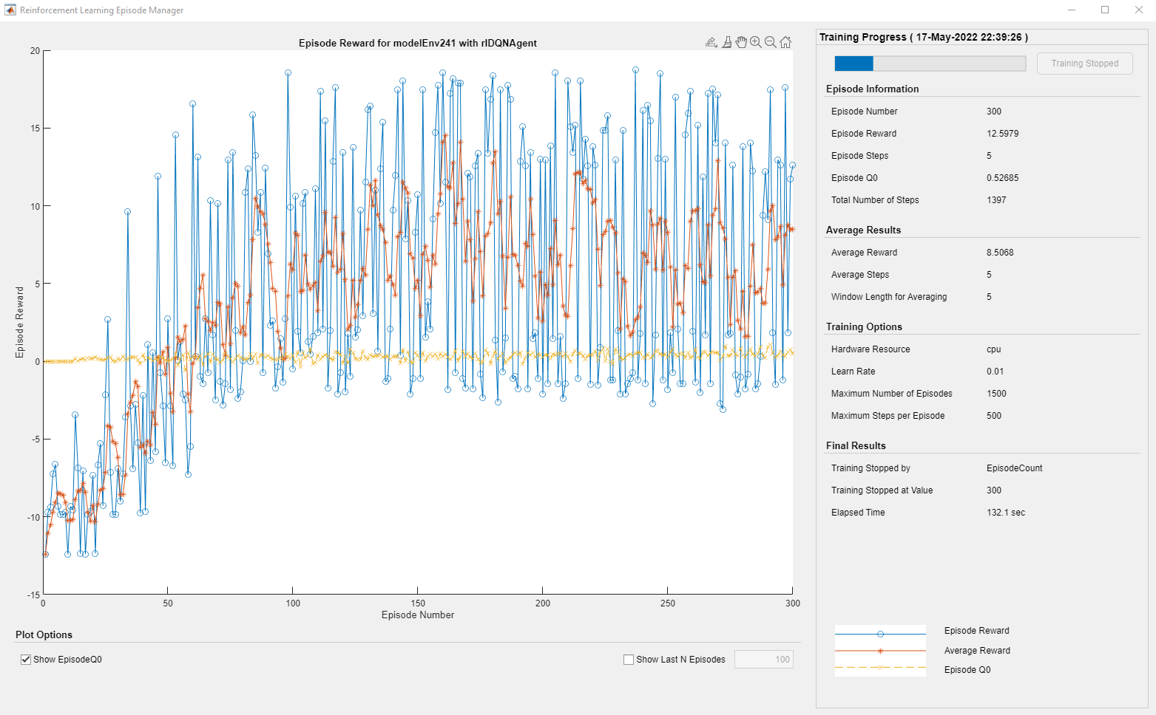
No U donors in training (6 random T donors)

Slide 2
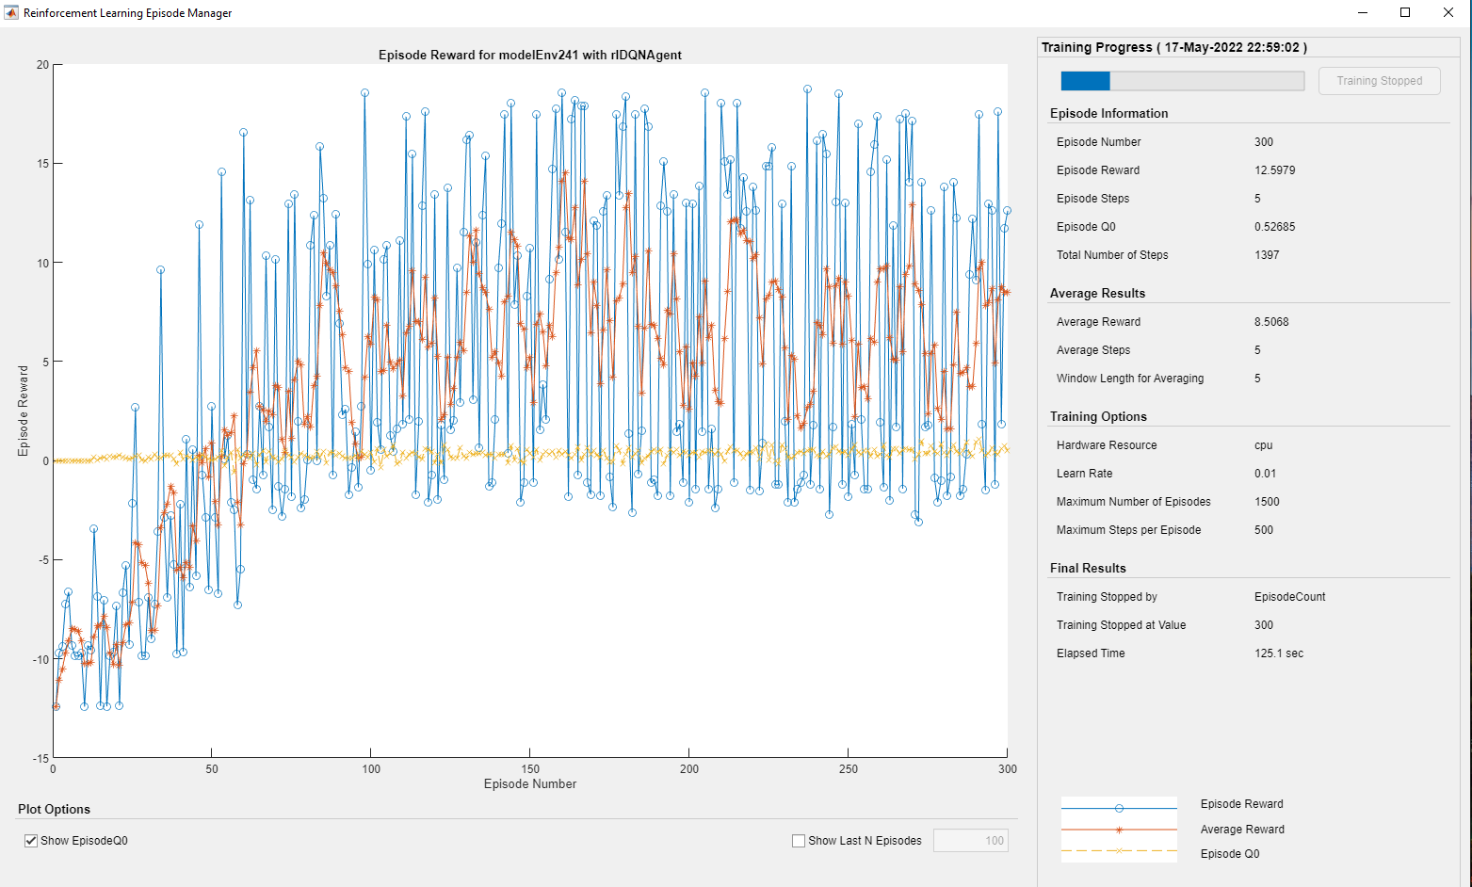
No U donors no T038 in training (6 random donors from the rest)

Slide 3
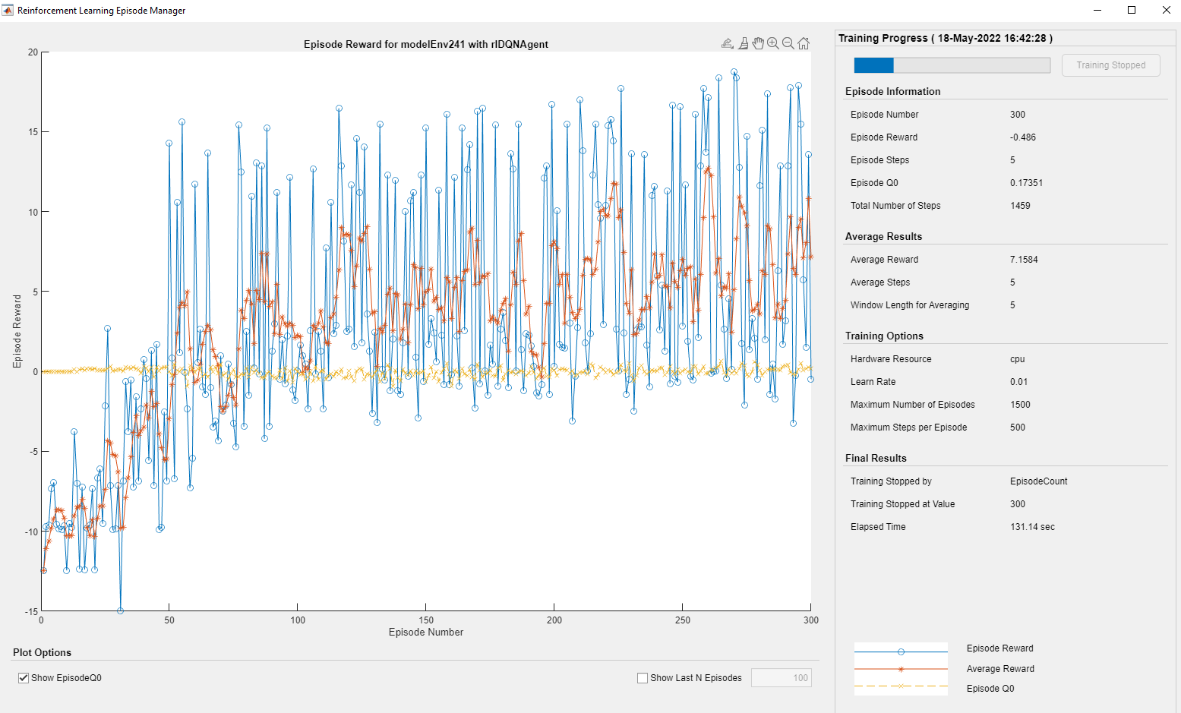
U donors + 6 random other donors

Slide 4
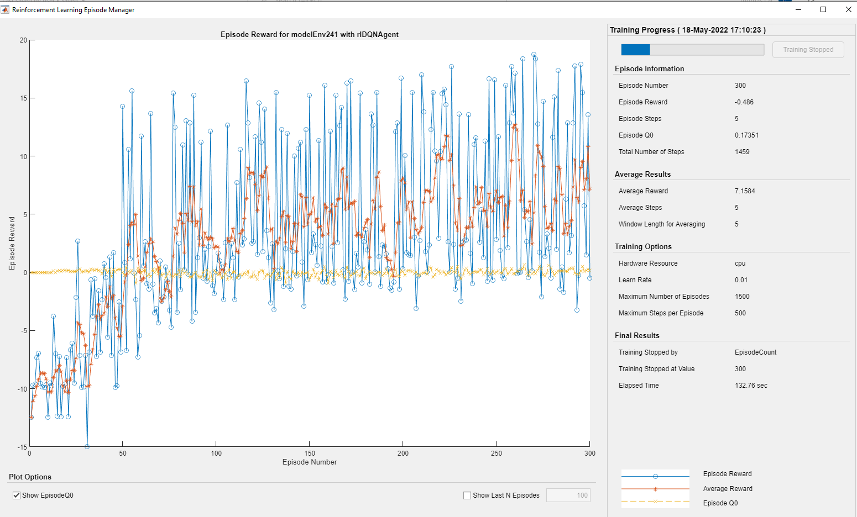
6 random donors + UA4 UA141

Slide 5
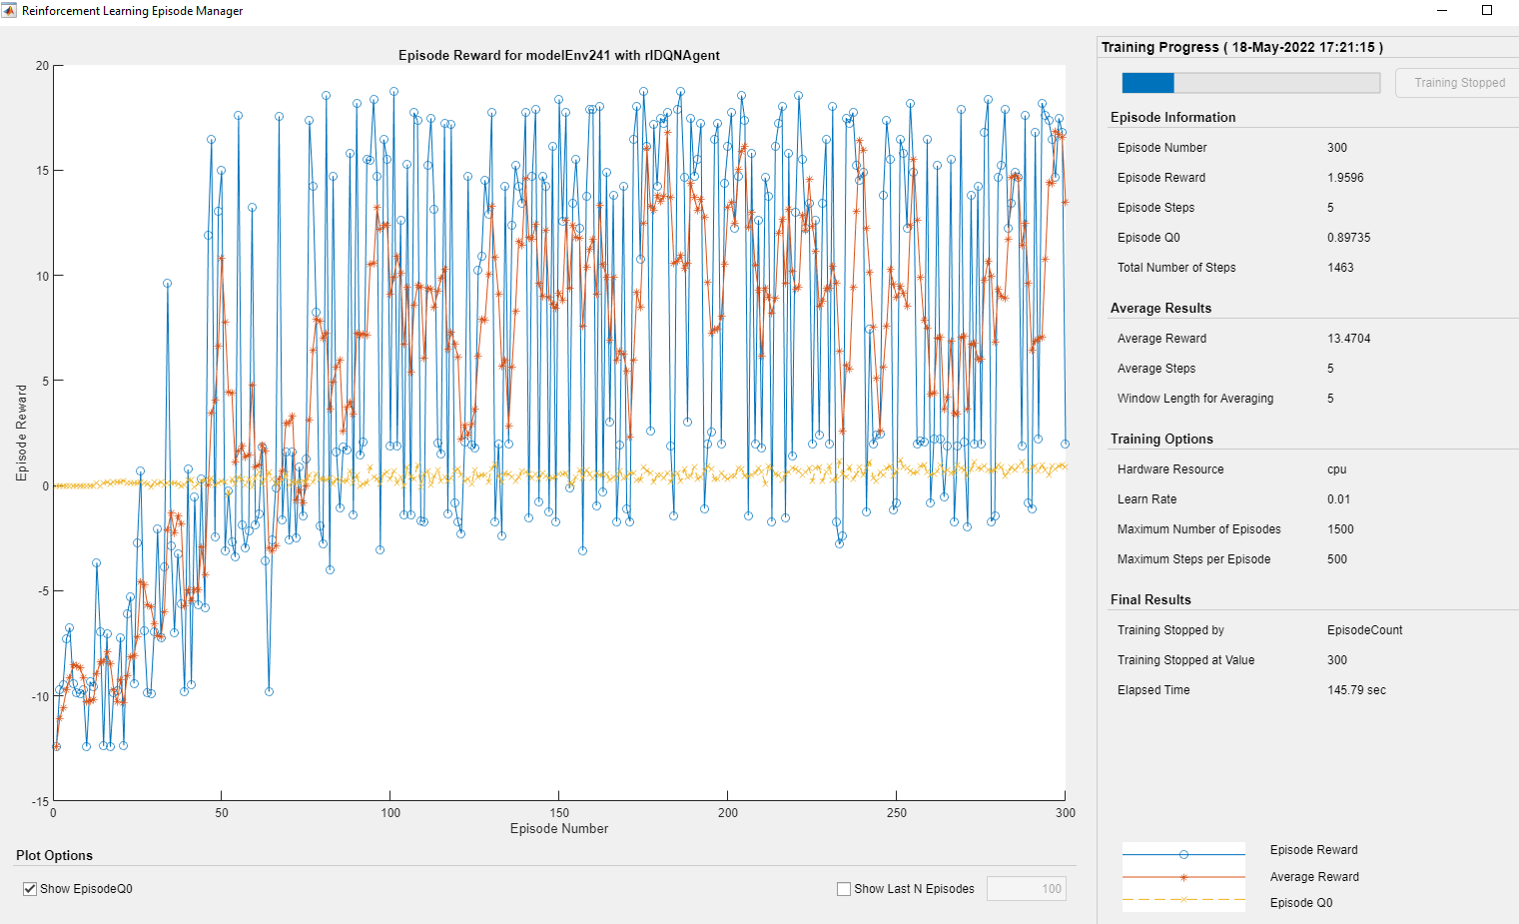
2 t donors plus UA4 and UA141

Slide 6
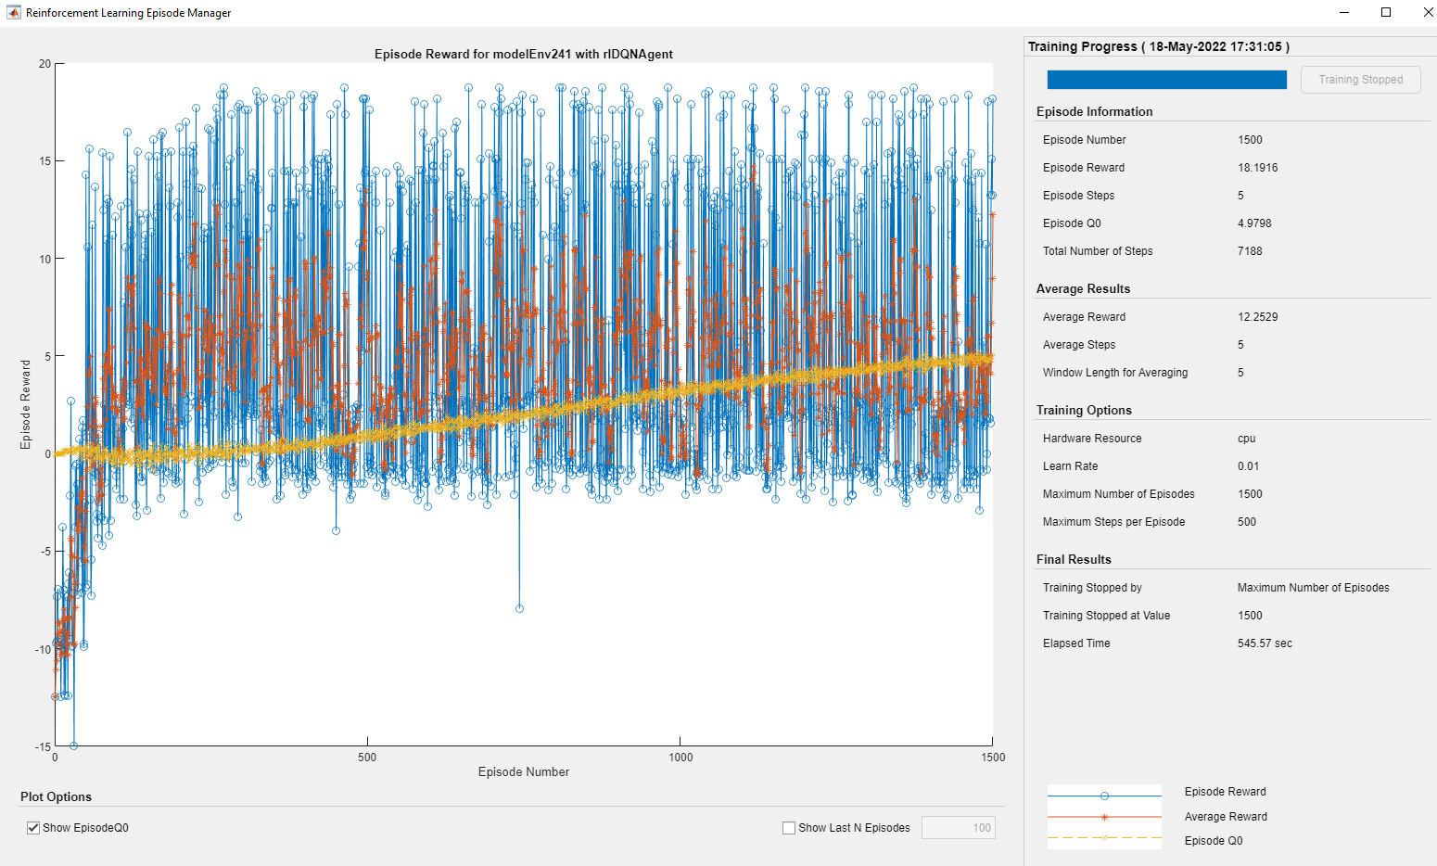
6 random donors + UA4 UA141
Training til average reward=15 or 1500 episodes, whichever comes first

Slide 7
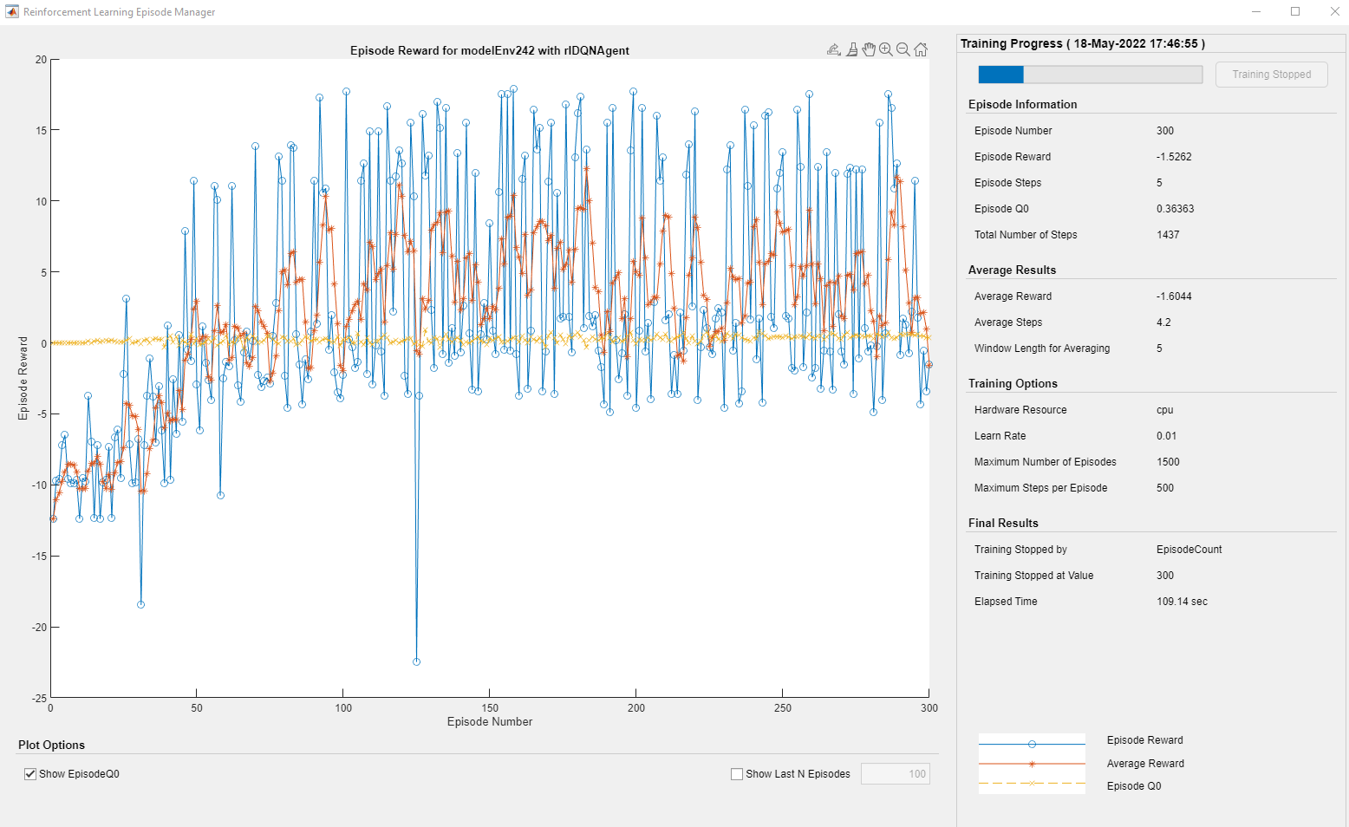
6 random donors + UA4 UA141
Stop experiment penalty

Slide 8
6 random donors + UA4 UA141
Stop experiment penalty
Training til average reward=15 or 1500 episodes, whichever comes first

